Slide 1
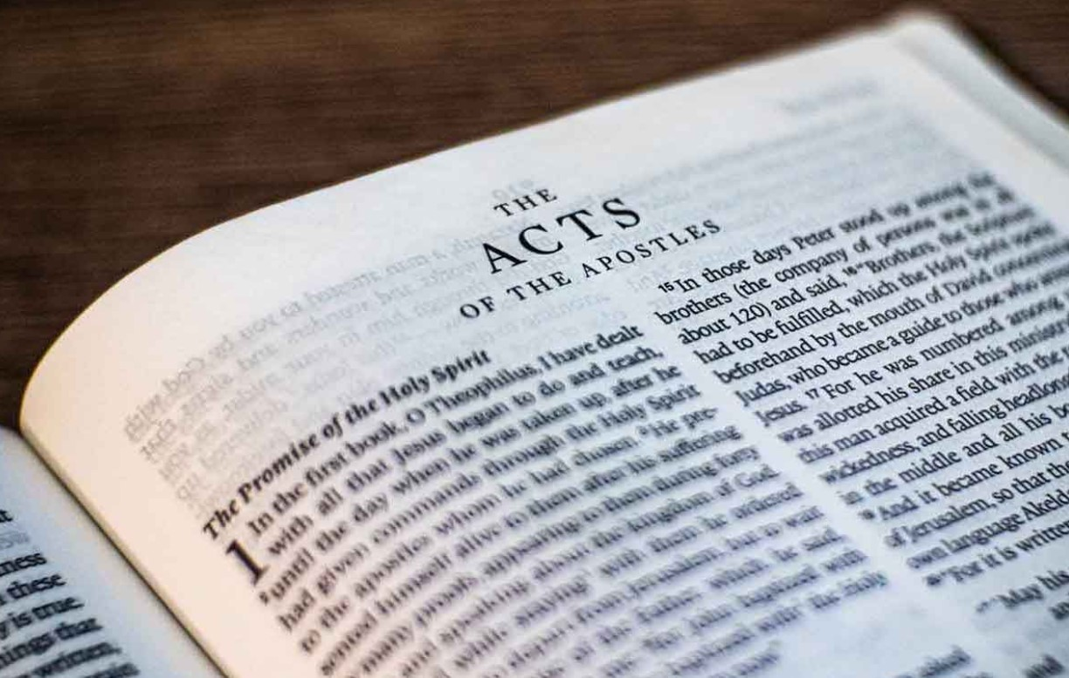
Go Tell The Good News
Acts – Part II

Slide 2
1)
2)
3)
4)
5)
6)
7)
8)
9)
10)
11)
12)
13)
14)
15)
Ascension & Appointment
Philippian Prison
16)
17)
18)
19)
20)
21)
22)
23)
24)
25)
26)
27)
28)
Pentecost & Peter’s Preaching
Addressing Athens
Lame Man & Lesson
Achaia, Antioch, & Apollos
Restrained, Released, & Request
Re-baptism, Repentance, & Riot
Deception & Detention
Macedonia & Miletus
Seven Selected
Stephen Stoned
Samaria & Salvation
Saul Saved & Dorcas Delivered
Cornelius Converted
Report & Relief
A
Persecution, Peter, & Pride
CTS
Antioch to Iconium
F
Iconium to Antioch
ACTS
Disagreement & Decision
Alliteration Memory Statements To Help Recall Chapter Content

Slide 3
1)
2)
3)
4)
5)
6)
7)
8)
9)
10)
11)
12)
13)
14)
15)
Ascension & Appointment
Philippian Prison
16)
17)
18)
19)
20)
21)
22)
23)
24)
25)
26)
27)
28)
Pentecost & Peter’s Preaching
Addressing Athens
Lame Man & Lesson
Achaia, Antioch, & Apollos
Restrained, Released, & Request
Re-baptism, Repentance, & Riot
Deception & Detention
Macedonia & Miletus
Seven Selected
Jerusalem & Jewish Mob
Stephen Stoned
Review & Rejection
Samaria & Salvation
Council & Conspiracy
Saul Saved & Dorcas Delivered
Caesarean Confinement
Cornelius Converted
Appeal & Agrippa
Report & Relief
A
Review & Ridicule
Persecution, Peter, & Pride
Marooned On Malta
CTS
Antioch to Iconium
F
Rescued To Rome
Iconium to Antioch
ACTS
Disagreement & Decision
Alliteration Memory Statements To Help Recall Chapter Content

Slide 4
Today’s class:
Acts 20:1-16
Summary of Paul’s letters to the Galatian churches & the church in Corinth
Journeys in Greece; summary of the letter to the Roman brethren; ministering at Troas
Paul in Miletus

Slide 5
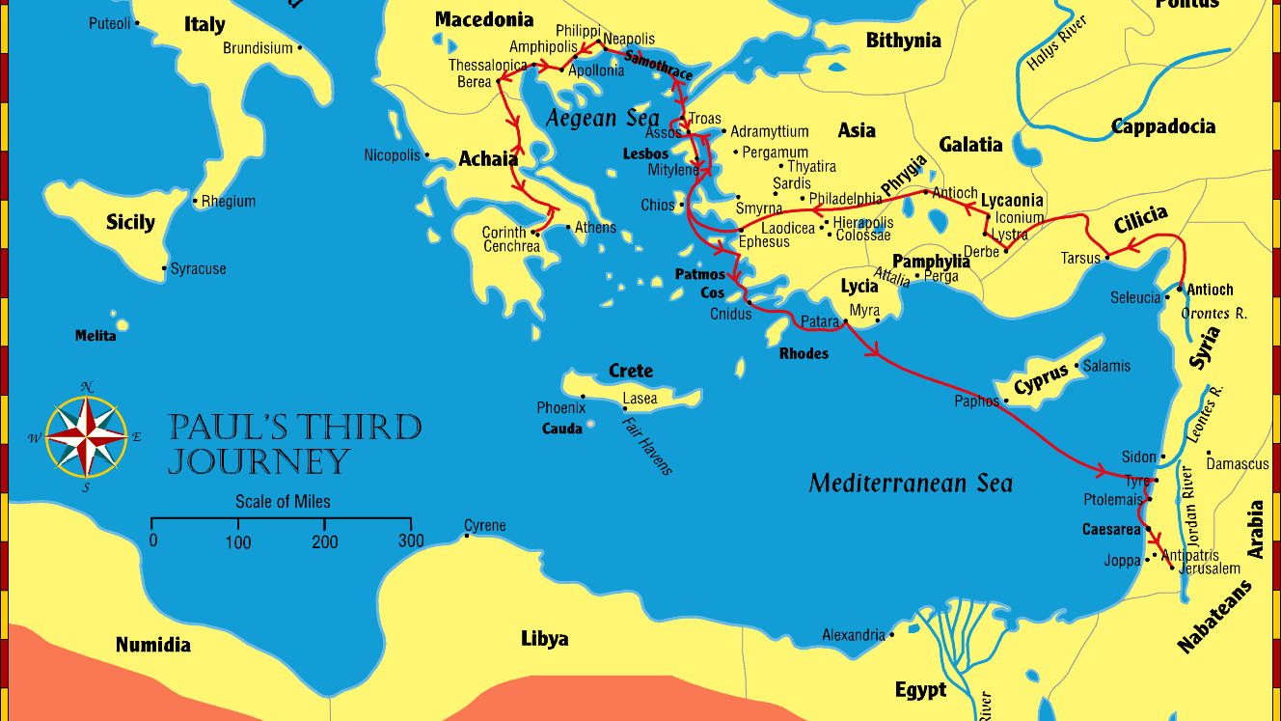
Paul visits the churches established on 1st journey, strengthening all the disciples (18:23)
Summary
Paul spends about 2 years in Ephesus

Slide 6
Paul’s letter to the Galatian churches
Time
No one knows exactly when it was written
Timing seems to be between A.D. 52 and 54
Seems to be written before Paul made the decision to collect a gift from Gentile churches to take to saints in Judea (he did not mention in the letter but saints from Galatia participated in the gift (1 Cor. 16:1; Acts 20:4)
Where was it written? No one knows for sure:
From Corinth at the close of Paul’s 2nd journey
From Antioch of Syria shortly before he set out on 3rd journey
From Ephesus, early in his stay in that city

Slide 7
Paul’s letter to the Galatian churches
Purpose
The churches of that region were facing a theological crisis. The essential truth of justification by faith rather than by human works was being denied by the Judaizers—legalistic Jews who insisted that Christians must keep the Mosaic Law. In particular, the Judaizers insisted on circumcision as a requirement for Gentiles who wished to be saved. In other words, convert to Judaism first, and then you are eligible to become a Christian. When Paul learned that this heresy was being taught to the Galatian churches, he composed an epistle to emphasize our liberty in Christ and to counter the perversion of the gospel that the Judaizers promoted.

Slide 8
Paul’s letter to the Galatian churches
Paul is amazed that the brethren have turned from the decrees that they had been taught so quickly (possibly seen during the early time period of 3rd journey?)
He begins the letter with a warning rather than thanksgiving

Slide 9
Summary of Galatians
Chapters 1-2: Paul’s defense of the gospel and his apostleship
Chapters 3-4: Justification by faith, not by the Law
Chapters 5-6: Freedom in Christ and the life of the Spirit

Slide 10
Summary of Galatians
Chapter 1:
Paul affirms his role as an apostle
Paul marvels at the brethren’s turning away from the grace of Christ to another gospel
Chapter 2:
Paul goes to Jerusalem with Barnabas after 14 years in regions of Syria and Cilicia
Refutes the false teaching that Gentiles must be circumcised before becoming Christians
Men are not justified by the works of the law but by faith in Jesus Christ

Slide 11
Summary of Galatians
Chapter 3:
The Galatians are foolish for believing they could achieve perfection through human effort after beginning with the Spirit.
The law was a guardian leading us to Christ, but now that faith has come, we are no longer under a guardian.
Chapter 4:
Comparing heirs to slaves, as they are under guardians until the set time by their father.
Paul uses the stories of Hagar and Sarah, Abraham's two wives, as an allegory for the two covenants.

Slide 12
Summary of Galatians
Chapter 5:
Christ has set us free for freedom’s sake; don’t submit again to a yoke of slavery
Warns of false teaching; a little leaven leavens the whole lump
Walk in the Spirit, not in the flesh
Chapter 6:
Those who are spiritual must restore one overtaken with sin in gentleness
Don’t grow weary in doing good; let us do good to all, especially to those who are of the household of faith

Slide 13
Paul’s 1st letter to the church at Corinth
Place & Time
Written while Paul was in Ephesus (~A.D. 53-55)
1 Cor. 16:8-9; great and effective door opened (possibly burning of books of magic (re: Acts 19:19))
Aquila and Priscilla were still in Ephesus when 1 Corinthians was written (1 Cor. 16:19)
Purpose
Paul’s letter to the Corinthian church, a diverse group of Jews and Gentiles, addresses internal divisions, moral issues, and doctrinal questions. He aims to correct errors, clarify misunderstandings about spiritual gifts and the Resurrection, and promote unity and holiness within the struggling congregation.

Slide 14
Summary of 1st Corinthians
Chapters 1-4: Divisions in the Church
Chapters 5-7: Issues of Immorality and Marriage
Chapters 8-10: Christian Liberty and Idolatry
Chapters 11-14: Worship, Spiritual Gifts, and Love
Chapter 15: The resurrection of the dead
Chapter 16: Final instructions and greetings

Slide 15
Summary of 1st Corinthians
Chapters 1-4: Divisions in the Church
Paul begins by addressing the divisions that have formed in the Corinthian church, with different groups claiming loyalty to various leaders (Paul, Apollos, Cephas). Paul urges the church to unite under Christ, emphasizing that Christ is the foundation, and human wisdom should not take precedence over God’s wisdom.

Slide 16
Summary of 1st Corinthians
Chapters 5-7: Issues of Immorality and Marriage
Paul rebukes the church for tolerating gross immorality, specifically a case of incest, and calls for church discipline. He also addresses lawsuits among believers, encouraging them to settle disputes within the church rather than in secular courts. In chapter 7, Paul gives practical advice on marriage, singleness, and sexual purity, urging believers to honor God with their bodies.

Slide 17
Summary of 1st Corinthians
Chapters 8-10: Christian Liberty and Idolatry
Paul discusses the issue of eating food sacrificed to idols, cautioning the Corinthians not to use their freedom in Christ in ways that may cause weaker believers to stumble. He emphasizes that love for others should guide their actions and that they should avoid idolatry at all costs.

Slide 18
Summary of 1st Corinthians
Chapters 11-14: Worship, Spiritual Gifts, and Love
These chapters focus on proper conduct in public worship, including the roles of men and women, the Lord’s Supper, and the use of spiritual gifts. Paul provides a detailed teaching on spiritual gifts, urging the Corinthians to seek gifts that build up the church, particularly prophecy.
Paul states that love is the most important Christian virtue, without which spiritual gifts are meaningless.

Slide 19
Summary of 1st Corinthians
Chapter 15: The resurrection of the dead
Paul addresses confusion regarding the resurrection of the dead. He explains the central importance of Jesus’ resurrection to the Christian faith and assures believers of their future resurrection. Paul describes the nature of the resurrection body and concludes with a triumphant declaration of victory over death through Jesus Christ.

Slide 20
Summary of 1st Corinthians
Chapter 16: Final instructions and greetings
Paul concludes the letter with practical instructions concerning the collection for the saints in Jerusalem and his travel plans. He sends personal greetings to various individuals and closes with a blessing of grace and love.

Slide 21
Acts 20:1-2a
Paul departs for Macedonia (churches at Philippi, Thessalonica, Berea)
Paul has “gone over that region and encouraged them with many words”

Slide 23
Paul’s 2nd letter to the church at Corinth
Place & Time
While in Macedonia, Paul was strengthened by the coming of Titus (re: 2 Cor. 7:5-7)
Purpose
Paul’s 2nd letter to the Corinthian church, addressing issues of reconciliation, defending his apostleship, and encouraging generosity. Paul emphasizes God’s comfort in suffering, the transformative power of the Spirit, and the importance of living a holy life.

Slide 24
Summary of 2nd Corinthians
Chapters 1-2: Paul’s Defense and Comfort in Affliction
Chapters 3-5: The ministry of the new covenant
Chapters 6-7: Exhortation to holiness and reconciliation
Chapters 8-9: Generosity and the collection for Jerusalem
Chapters 10-13: Paul’s apostolic defense and strength in weakness

Slide 25
Summary of 2nd Corinthians
Chapters 1-2: Paul’s Defense and Comfort in Affliction
Paul begins by expressing his comfort in God, who comforts believers in all their troubles, so they can comfort others (2 Corinthians 1:3-4). He then addresses the tension between him and the Corinthian church, explaining his change of travel plans and emphasizing his sincere love and forgiveness toward them.

Slide 26
Summary of 2nd Corinthians
Chapters 3-5: The ministry of the new covenant
In these chapters, Paul contrasts the old covenant, symbolized by the Law of Moses, with the new covenant brought by Christ. He describes the ministry of the new covenant as one of life and the Spirit, not of the letter and death. Paul also teaches about the transient nature of life on earth and the eternal hope believers have through the resurrection, encouraging them to walk by faith, not by sight.

Slide 27
Summary of 2nd Corinthians
Chapters 6-7: Exhortation to holiness and reconciliation
Paul calls the Corinthians to live holy lives, not to be unequally yoked with unbelievers, and to cleanse themselves from anything that defiles the body and spirit. He then urges the church to open their hearts to him and receive him as a faithful apostle of Christ, seeking reconciliation and mutual understanding.

Slide 28
Summary of 2nd Corinthians
Chapters 8-9: Generosity and the collection for Jerusalem
Paul devotes these chapters to the subject of generosity, encouraging the Corinthians to contribute to the collection for the impoverished believers in Jerusalem. He uses the example of the Macedonian churches to inspire the Corinthians to give willingly and cheerfully, teaching that God loves a cheerful giver and will bless their generosity.

Slide 29
Summary of 2nd Corinthians
Chapters 10-13: Paul’s apostolic defense and strength in weakness
In the final chapters, Paul defends his apostleship against accusations from false teachers who have undermined his authority. He explains the marks of true apostleship, which include suffering and humility. Paul shares his famous “thorn in the flesh” experience, through which God taught him that His grace is sufficient and that His power is made perfect in weakness. The letter concludes with an exhortation to examine themselves and a final blessing.

Slide 30
Acts 20:2b-3
Paul goes to Greece and stays 3 months
While in Corinth, Paul writes the letter to the brethren in Rome

Slide 31
Paul’s letter to the church at Rome
Place & Time
Probably written in Corinth during the 3rd missionary journey with the assistance of Tertius (Rom. 16:22)
Purpose
To proclaim the glory of the Lord Jesus Christ by teaching doctrine and edify and encourage the believers who would receive his letter. Of particular concern to Paul were those to whom this letter was written—those in Rome who were “loved by God and called to be saints” (Romans 1:7). Because he himself was a Roman citizen, he had a unique passion for those in the assembly of believers in Rome. Since he had not, to this point, visited the church in Rome, this letter also served as his introduction to them.

Slide 32
Summary of the letter to the church at Rome
Chapters 1-4: The need for and the nature of righteousness
Chapters 5-8: The results of righteousness
Chapters 9-11: God’s righteousness and Israel
Chapters 12-15: Practical Christian living
Chapter 16: Final greetings and commendations

Slide 33
Summary of the letter to the church at Rome
Chapters 1-4: The need for and the nature of righteousness
Paul begins by outlining the sinful condition of humanity—both Jew and Gentile—stating that all have sinned and fallen short of the glory of God (Romans 3:23). He explains that no one is justified by the works of the law but rather through faith in Jesus Christ. Using the example of Abraham, Paul teaches that justification has always been by faith, not by works.

Slide 34
Summary of the letter to the church at Rome
Chapters 5-8: The results of righteousness
In these chapters, Paul delves into the benefits of being justified by faith. He describes how believers have peace with God through Jesus Christ and the hope of eternal life. Paul contrasts the results of Adam’s sin, which brought death, with the results of Christ’s obedience, which brings life. He also discusses the role of the Holy Spirit in sanctification, explaining that through the Spirit, believers are freed from the power of sin and can live a life that pleases God.

Slide 35
Summary of the letter to the church at Rome
Chapters 9-11: God’s righteousness and Israel
Paul addresses the question of Israel’s role in God’s plan of salvation. He expresses his sorrow over Israel’s rejection of Christ but affirms that God has not rejected His people. Paul explains that salvation is available to all who believe, both Jews and Gentiles, and that God’s promises to Israel will be fulfilled. These chapters highlight God’s sovereign plan and mercy.

Slide 36
Summary of the letter to the church at Rome
Chapters 12-15: Practical Christian living
In these chapters, Paul shifts from doctrine to practice. He calls believers to live sacrificially and in humility, offering themselves as living sacrifices to God (Romans 12:1). Paul exhorts the church to live in harmony, love one another, and serve using the spiritual gifts they have received. He also discusses the importance of submitting to governing authorities and bearing with the weaknesses of others, especially in matters of personal conscience.

Slide 37
Summary of the letter to the church at Rome
Chapter 16: Final greetings and commendations
The letter concludes with personal greetings to various individuals in the Roman church, demonstrating Paul’s affection for the believers there. He also warns against divisions in the church and encourages the believers to remain steadfast in the gospel.

Slide 38
Acts 20:4-6
Paul has several of the prominent men from various areas accompany him to Asia
Sopater of Berea - Perhaps the same person who, in Romans 16:21, is called Sosipater, and who is there said to have been a kinsman of Paul.
Aristarchus - Reference Acts 19:29.
Gaius of Derbe - Reference Acts 19:29.
Tychicus - This man was high in the confidence and affection of Paul. In Ephesians 6:21-22 he styles him "a beloved brother, and faithful minister in the Lord."
Trophimus - Trophimus was from Ephesus, Acts 21:29. When Paul wrote his Second Epistle to Timothy he was at Miletum, sick, 2 Timothy 4:20.

Slide 39
Acts 20:7-12
In Troas, the men met with the brethren on the first day of the week
“Upon the first day of the week, when the disciples came together to break bread…”
Paul speaks until midnight and Eutychus falls from a third story window; the brethren take him up dead
Paul, goes down and falls on him and embraces him, and he is restored to life
The brethren are greatly comforted by the healing of Eutychus

Slide 40
Acts 20:13-16
Paul and his companions travel from Troas to Miletus

Slide 41
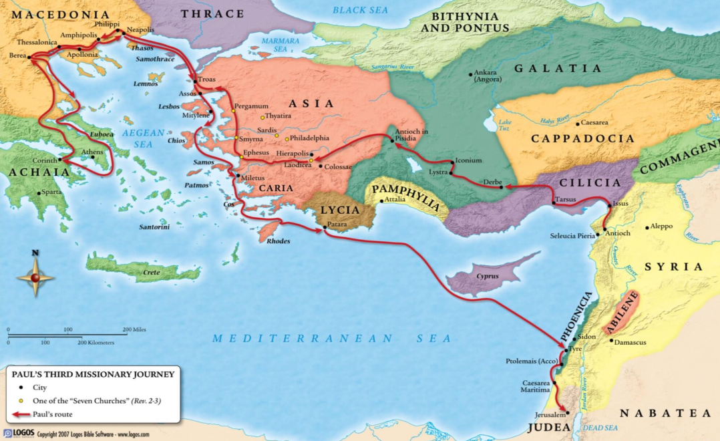
Acts 20:13-16
Paul and his companions travel from Troas to Miletus

Slide 42
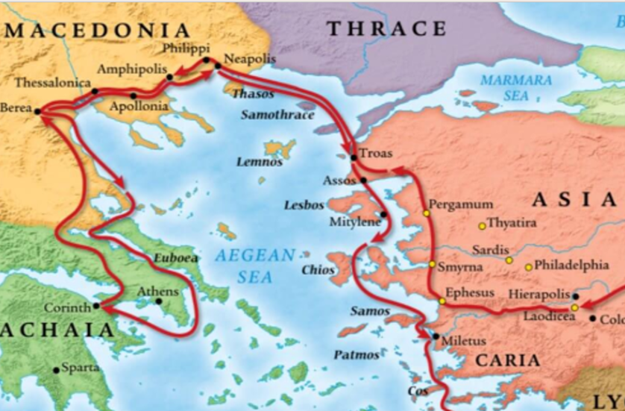
Acts 20:13-16
Paul and his companions travel from Troas to Miletus

Slide 43
Acts 20:13-16
Paul and his companions travel from Troas to Miletus
“For Paul sailed past Ephesus, so that he would not have to spend time in Asia; for he was hurrying to be at Jerusalem, if possible, on the Day of Pentecost” (Acts 20:16)

